Slide 1

W251 Final Project
Tiki Video Q & A System
Brent Biseda, Vinicio De Sola, Pri Nonis, Kevin Stone

Slide 2
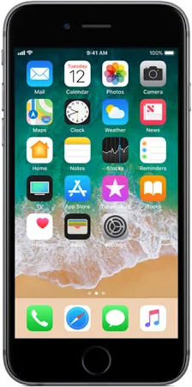
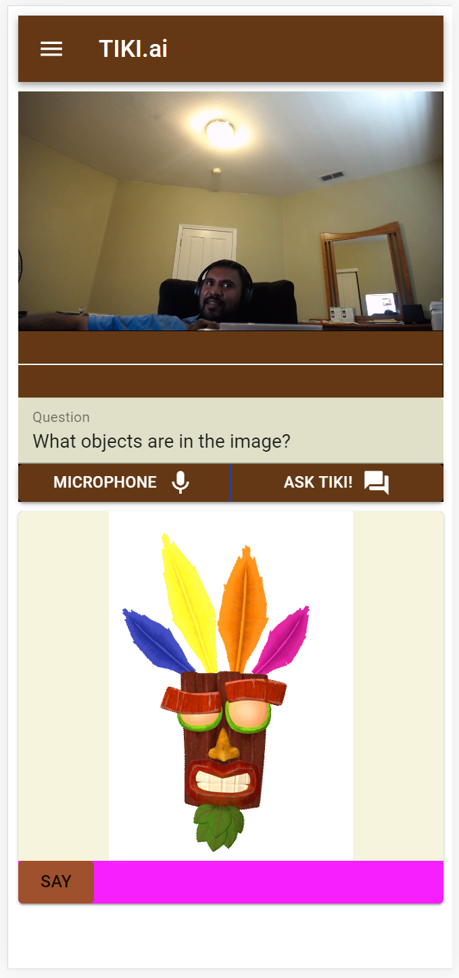
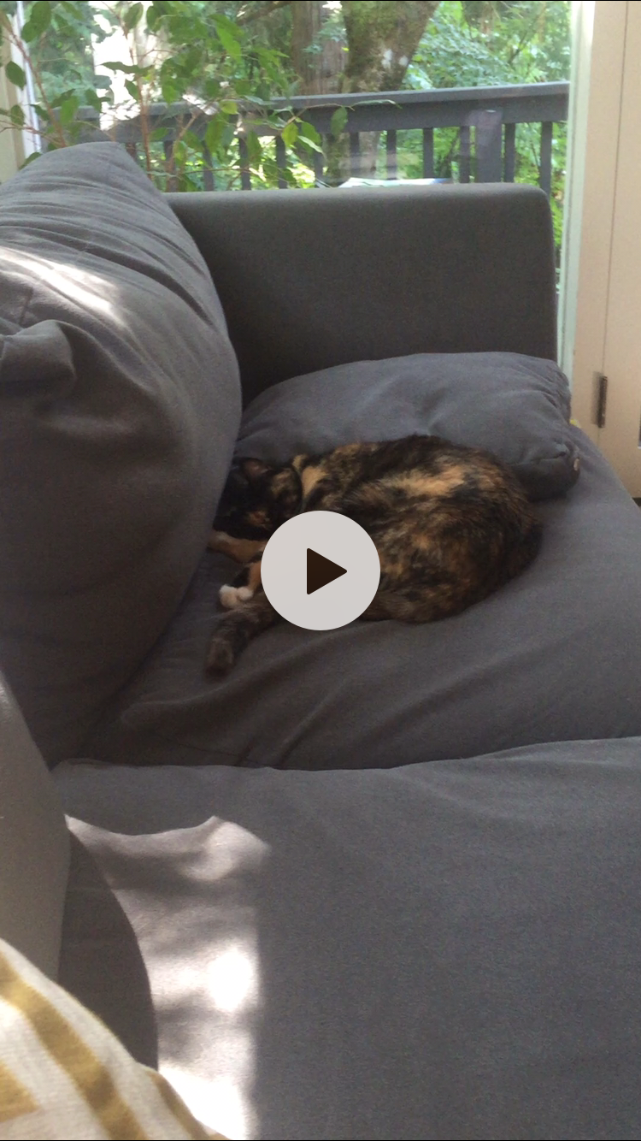
Overview
Tiki makes any video stream queryable via text or voice
“What objects are in the image?”
“Which # is taking a shot?”
“What is the weather outside?”
Works with any browser, no software
required to be installed

Slide 3




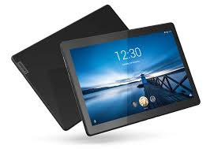
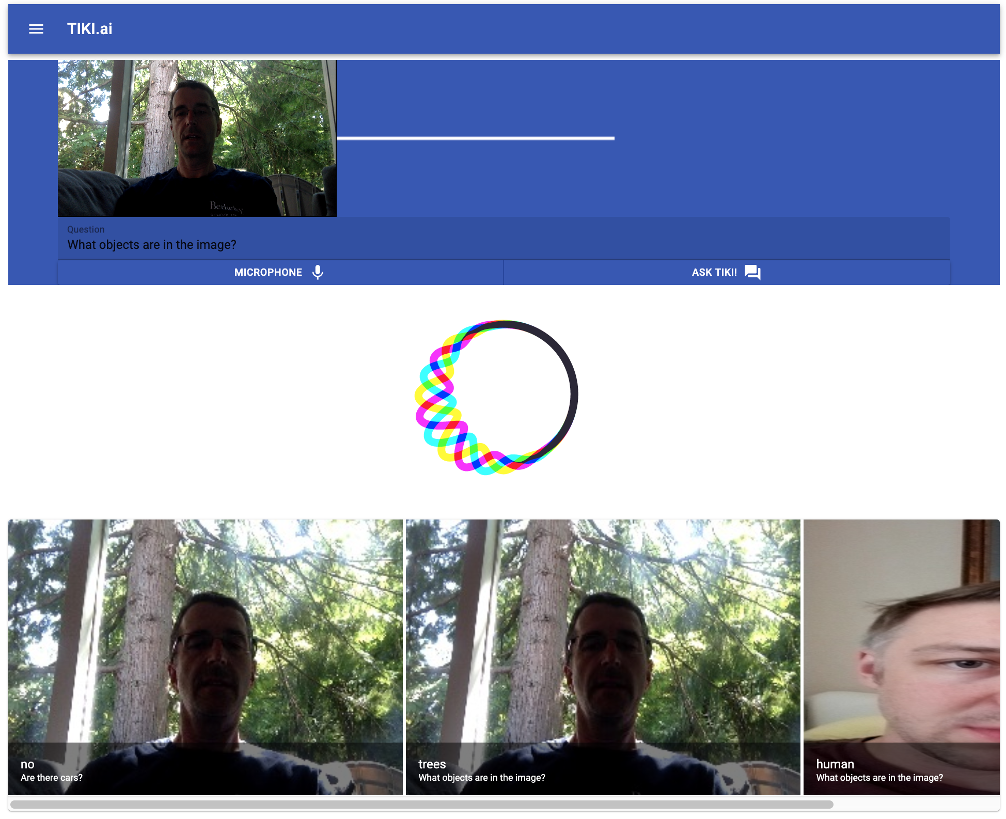
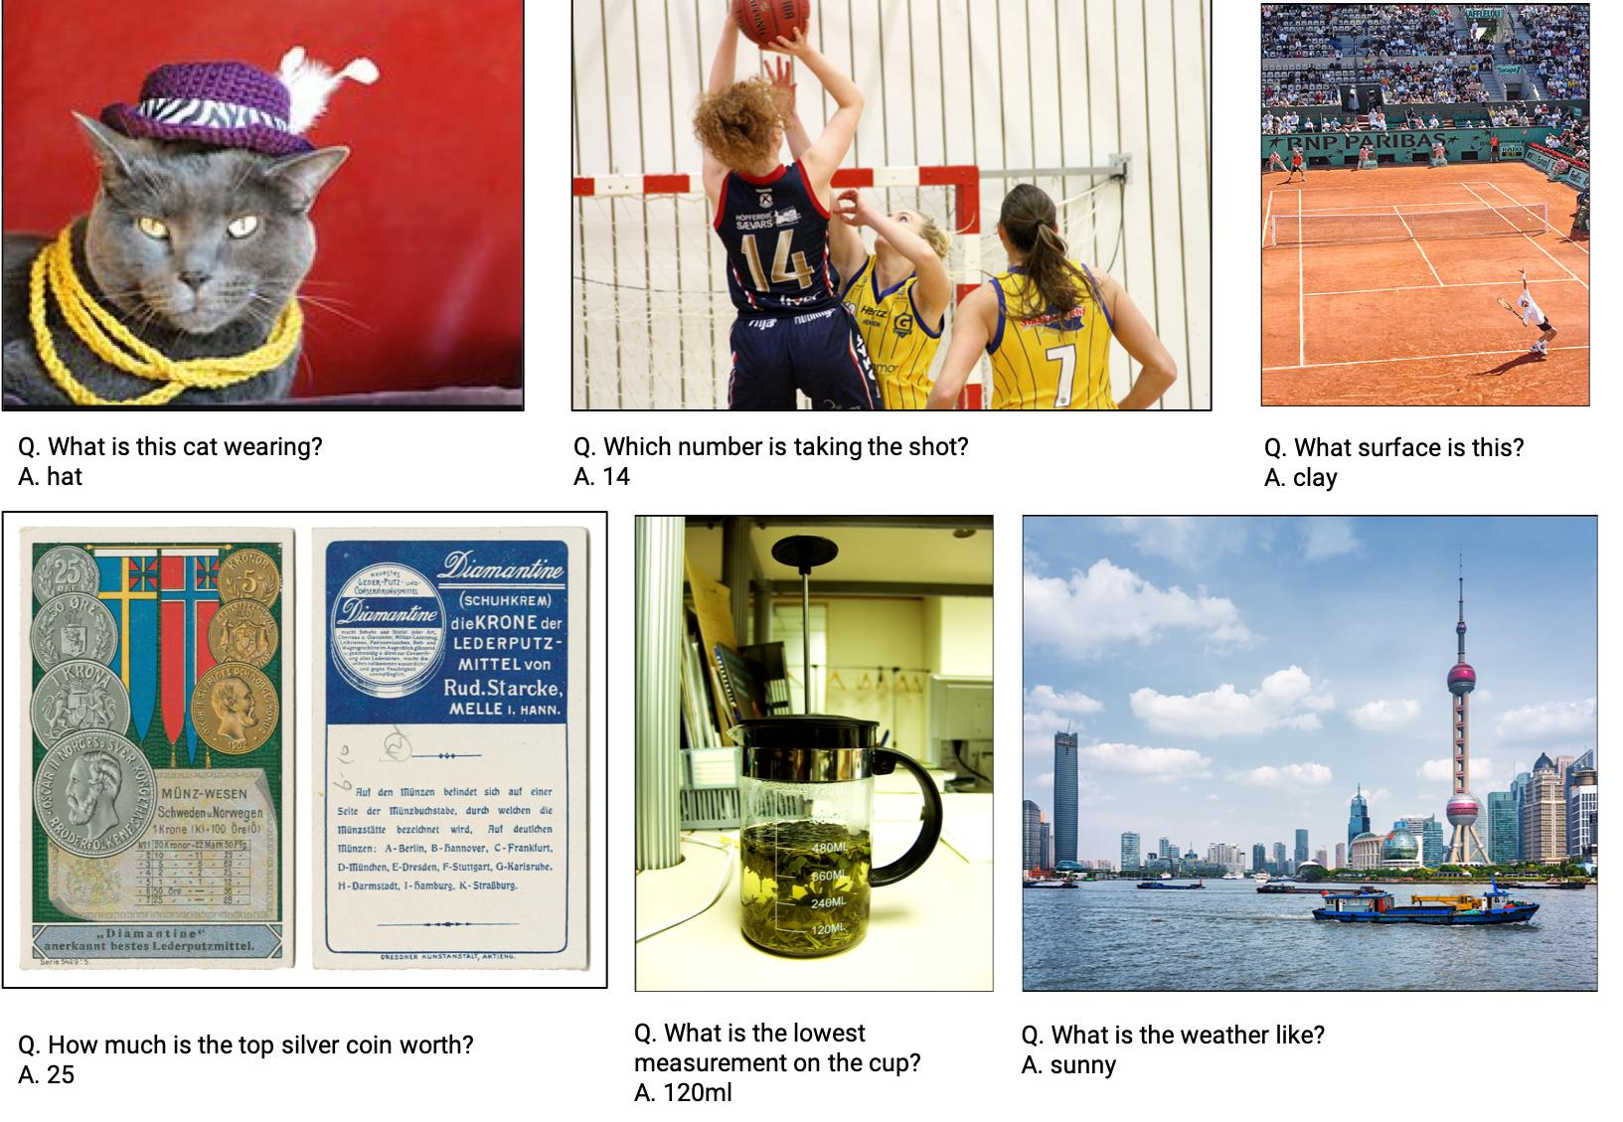
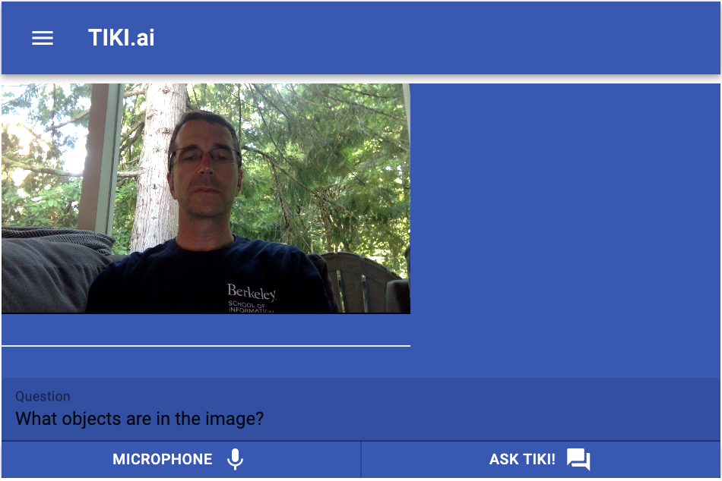

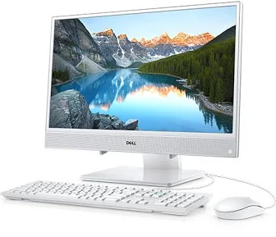



Architecture
Image
Text Query
“What objects are in the image?”
Meteor
(React + JS)
Secure HTTP
“Which # is taking a shot?”
Audio File
“What’s the weather like?”
Speech-to-Text

Slide 4
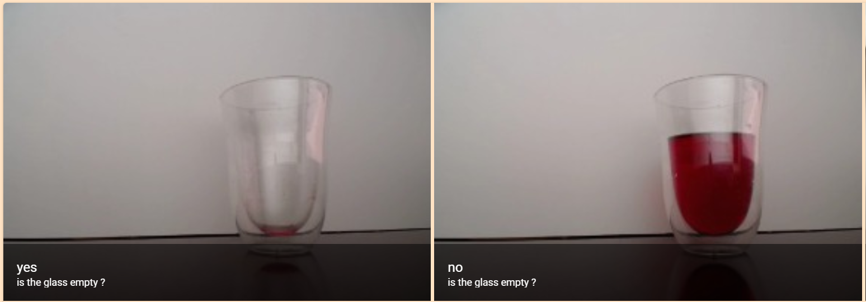
Is Pythia an optimist or a pessimist?

Slide 5
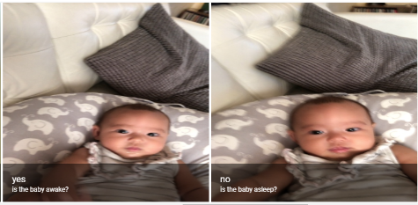
Do I need to entertain my baby?

Slide 6



Front-end Overview
Full-stack JavaScript platform for developing modern web and mobile applications.
JavaScript library for building user interfaces.
User interface component package.

Slide 7
Pythia Overview
Developed by Facebook AI Research
‘Pythia’ is an homage to the Oracle of Apollo at Delphi
Designed for answering questions related to visual data and automatically generating image captions
Modules for question encoding, image feature extraction, fusion of the two (typically with attention), and classification over the space of answers.
Support for various datasets built-in including VQA, VizWiz, TextVQA, VisualDialog and COCO Captioning.
Built on open-source PyTorch framework
Notes:
Developed by Facebook AI Research
The name ‘Pythia’ is an homage to the Oracle of Apollo at Delphi, who answered questions in Ancient Greece.
Designed for vision and language tasks, such as answering questions related to visual data and automatically generating image captions
Modules for question encoding, image feature extraction, fusion of the two (typically with attention), and classification over the space of answers.
Support for various datasets built-in including VQA, VizWiz, TextVQA, VisualDialog and COCO Captioning.
Built on open-source PyTorch framework

Slide 8
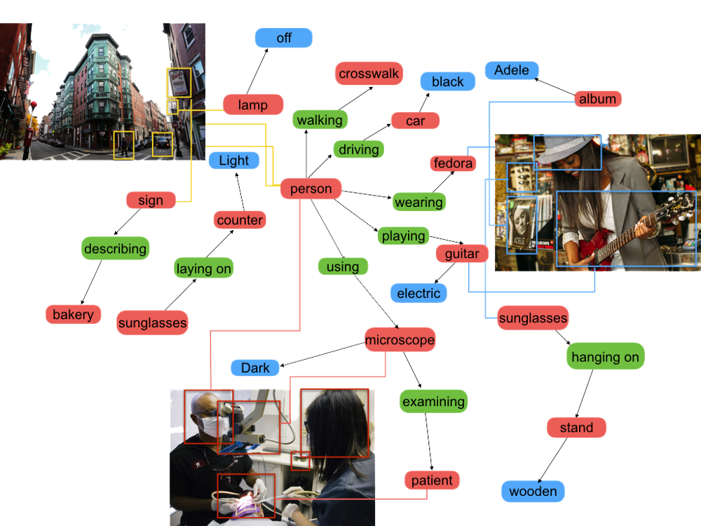
Pythia Details - Bottom-up & Top-Down Attention
Used object detector to extract image features with bottom-up attention.
ResNet-101 for backbone network.
Uses Visual Genome, knowledge base to connect structured image concept to language.
The question text is then used to compute the top-down attention
Uses GloVe (Global Vectors) word embeddings -> GRU network and a question attention module to extract text features
Reached 70.34% on VQA 2.0 with an ensemble of 30 models.
Source: https://mc.ai/pythia-facebook-greek-god-doing-deep-learning/
Notes:
Used object detector — Faster RCNN pre-trained on the Visual Genome dataset — to extract image features with bottom-up attention.
A ResNet-101 was chosen as the backbone network. Visual Genome is a knowledge base to connect structured image concept to language.
The question text is then used to compute the top-down attention, i.e., task-specific attention, for each object in the image.
Use GloVe (Global Vectors) then pass the word embeddings onto a GRU network (Gated Recurrent Unit-a LSTM with a forget gate) and a question attention module to extract attentive text features and discard unnecessary ones.
The performance reached 70.34% on VQA 2.0 test-std split with an ensemble of 30 models.

Slide 9

Pythia Performance on V100
Initialization: 16.125 Seconds
Tiki : Initializing : Device Type is cuda
Tiki : Initializing : Building - Text Processors
Tiki : Initializing : Building - ResNet152
Tiki : Initializing : Building - Detectron
Tiki : Initializing : Building - PythiaVQA
Inference: 1.5 seconds

Slide 10
Google Cloud Speech-Text Overview
Processes real-time streaming or prerecorded audio
Can return recognized text from audio stored in a file
Capable of analyzing short-form and long-form audio
Can stream text results, immediately returning text as it’s recognized from streaming audio or as the user is speaking
API recognizes 120 languages and variants
Automatically identifies spoken language

Slide 11
¡Demo Time!

Slide 12
¡Demo Time!
Now try it yourself! Goto www.tiki.systems from your mobile phone

Slide 13
Future Work (Pending Funding)
Near-term
UI Updates
Public API and Github Repo
Medium Article
Longer-term
Integration with smart home devices: Alexa / Siri / Nest Cameras / Ring
Industry-specific training: Healthcare triage, Home surveillance
IPO

Slide 14

Future Work (Pending Funding)
QUESTIONS?
THANK YOU!
Near-term
UI Updates Left To Do?
Public API?
???
Longer-term
Integration with smart home devices: Alexa / Siri / Nest Cameras / Ring
Industry-specific training: Healthcare triage, Home surveillance
???

